Slide 1
LGE Confidential
2023
LG Sound Bar E-Learning

Slide 2
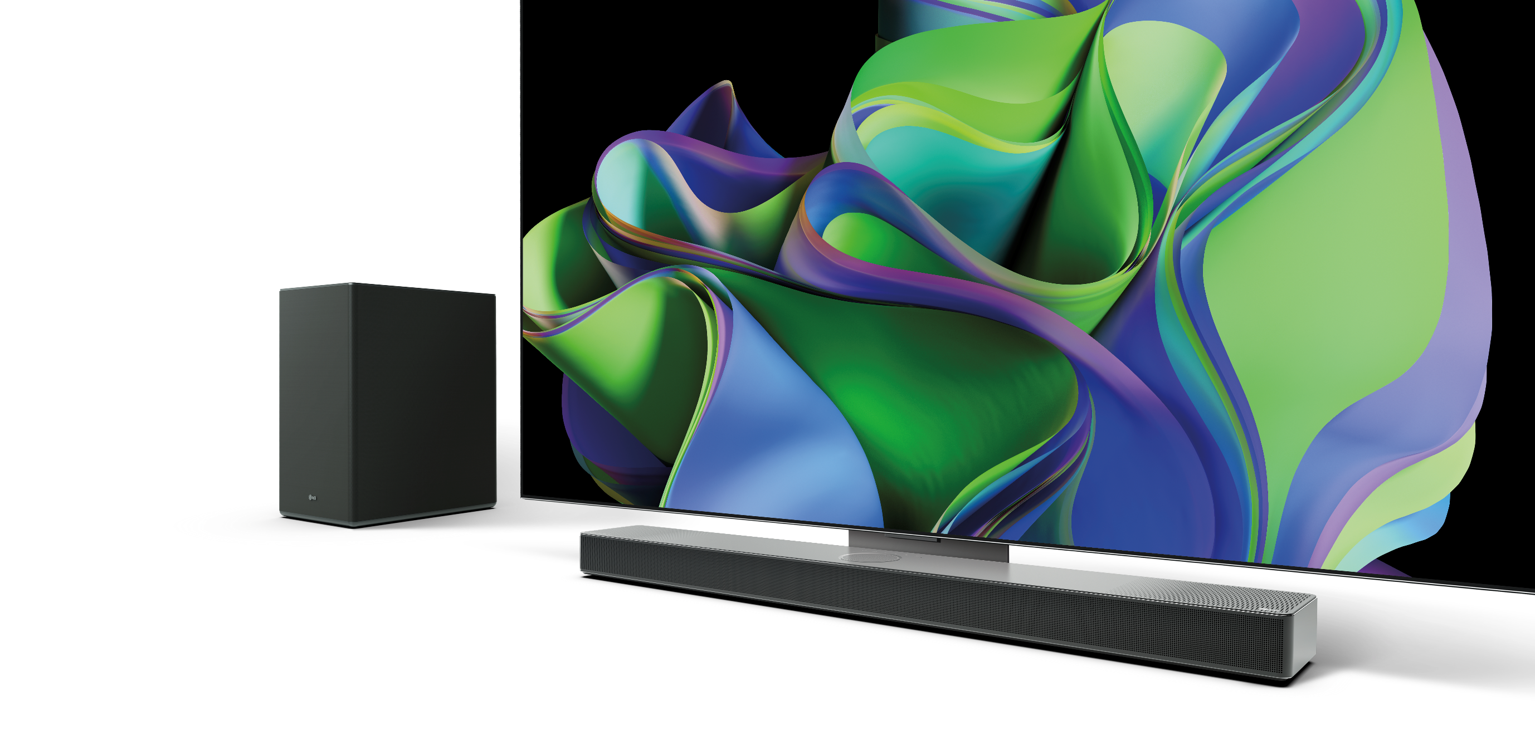
2023
LG Sound Bar
OLED C Matching Sound Bar / SC9S

Slide 3
Key Feature Evolution
Provides a whole-new sound experiences by focusing on improving the fundamentals of sound quality, enhancing 3D immersive sound
2023
TV Synergy
WOW Orchestra
WOW Interface
WOW Bracket
NEW
Clear Voice Plus
4K@120Hz
Smart
Up-mixer
Triple Level
Spatial Sound
AI Room
Calibration Pro
2022
Deep & Clean Bass Subwoofer
VRR
Triple Up-Firing
6ch Rear Speaker
with Up-firing
ALLM
Carbon Trust
2021
4ch Rear Speaker
Hi-Res Audio
AI Room
Calibration
Works with
with Up-firing
Wireless Dolby Atmos
AI Sound Pro
eARC
UL ECV
SGS
Low-Vibration
Subwoofer
Basic sound
Quality
Surround
Sound
Rear
Speaker
Hi-Resolution
Audio
Sound
Optimization
Installation /
Connectivity
AI / Smart
Eco
Notes:
Please review the evolution of features that LG has implemented into our Soundbar lineup over the last few years. LG strives to provide the best home audio experience possible regardless of the user. Whether you are a music lover, an avid gamer, or a Film buff – LG has the right audio solution for you. And we have improved our synergy with LG OLED TVs in order to make the combination of LG Soundbar more appealing with customers who purchase LG OLED TVs.

Slide 4
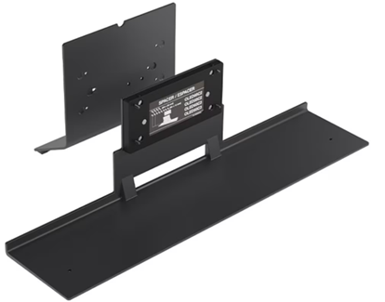
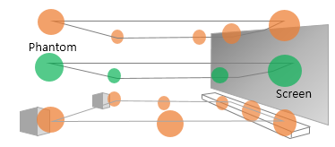
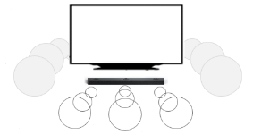
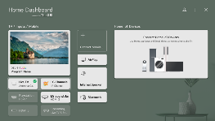
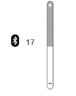
`23 New Feature Overview
1
TV + Sound Bar Synergy
2
Immersive Sound
3
Lifestyle
『 TV and Sound Bar that works as single product 』
『 Triple AI Sound』
『 Perfect solution for any usage case 』
■ WOW Bracket :
■ Triple Level Spatial Sound
Provides a seamless installation application of SC9S soundbar with LG C series OLED evo TV (In both Table top and wall mounted applications)
■ Hi-Fi Music Streaming
Virtual mid-layer provides more immersive 3D surround sound. front & top channel synthesis and HRTF-based 3D engine create a virtual speaker in the middle layer
Enjoy MQA quality hi-res music streaming service with TIDAL connect available LG Wi-Fi Sound Bar
■ WOW Orchestra
`22
Provides rich surround effect by using TV speakers with the LG Sound Bar at the same time
New
■ WOW Interface :
■ Smart Up-Mixer
Even 2 channel sources are divided into multi-channels optimized for Sound Bar speaker configuration
■ HDMI 2.1 compatibility
Intuitively displays the connection status of the TV and the sound bar on the TV screen
Fully compatible with a various external devices
2ch
Smart
Up-mixer
9.1.5ch*
New
+
Pass-through
■ AI Room Calibration pro
Automatically change to Sound Bar’s Sound Effects when connecting LG TV to Sound Bar
The Calibration frequency band is expanded from 200Hz to 400Hz (It covers front & Center channel band) to improve the balance and loudness of voice
60Hz
120Hz
Improved Volume UI Design for external audio devices connection
■ Cinematic Home Theatre
■ Clear Voice Plus
Correlation analysis of L/R channels delivers more realistic center and center up-firing channel which provides a clearer voice
With IMAX enhanced – be immersed in cinematic audio crafted the way the audio masters intended you to hear it
*S95QR used in this example – the output matches to the LG Sound Bar speaker configuration
Notes:
We can look at our 2023 improvements and products in 3 main categories.
TV + Sound Bar Synergy
Cosmetic Synergy with WOW Bracket
The WOW Bracket comes in the box with the SC9S Soundbar. This allows you to attach the Soundbar to the 55/65/77” C series OLD evo TV (The soundbar becomes the base for the TV). This is possible in both table-top and mounted TV installation applications. This will save you having to drill additional holes into the wall if you want to wall mount your Soundbar. It will also save space on the table if you’re matching with a TV that is sitting on a table.
Audio Synergy with WOW Orchestra and WOW Interface
WOW Orchestra will incorporate the TV Speakers and the Soundbar audio output simultaneously for a more immersive and full audio experience.
WOW Interface allows better interactivity with the Soundbar, while using the TV Remote, by adding visual control menus on the TV that control the soundbar. Adjust soundbar audio settings by selecting preset audio modes right from the TVs audio menu using the LG Magic Remote.
Immersive Sound
Triple Level Spatial Sound
Our Atmos Sound Bar models utilize the front firing channels create an immersive 2D audio layer and the upfiring channels add height to the immersion. There may be an audio gap separating these two sound fields, though. Triple Level Spatial Sound bridges the audio gap between these two sound fields for a fuller more robust sound field.
Smart Up-Mixer
Upconverts as low as 2 channel audio to match the sound configuration of the LG Soundbar that you are connected to. For example, the S95QR is 9.1.5 -> So the Smart Up-mix feature would be able to upconvert audio passed through into the S95QR into 9.1.5.
AI Room Calibration Pro
LG Soundbars will match the sound for your space. Whether your space has higher ceiling, deeper seating area or multiple tables and couches, our AI Room calibration will optimize the sound output for your unique listening environment.
Clear Voice Plus
Select this option to amplify speaking, dialogue etc
Lifestyle
Tidal Connect now added for 2023
Hi Fidelity music streaming utilizing MQA technology – streamed wirelessly (via a compatible mobile device on the Tidal Application) to your compatible LG Soundbar. Audiophiles will love this new feature which brings the best music formats to the high performing LG Soundbar.
HDMI 2.1
Save TV ports by plugging your console directly into your compatible LG Soundbar. Maintain your optimized gaming experience by passing VRR, ALLM and (new for 2023) 120Hz , via HDMI, through your LG Soundbar.
Cinematic Home Theatre
Immersive cinematic audio as the people at IMAX intended
With a premium 2023 LG TV and an IMAX Enhanced Audio LG Sound Bar you can now hear and see Disney+ IMAX Enhanced media

Slide 5
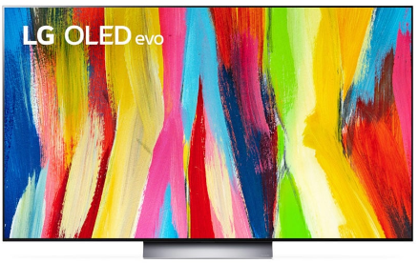
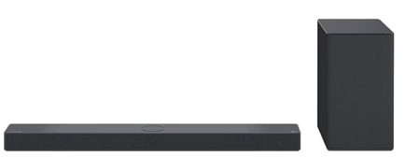
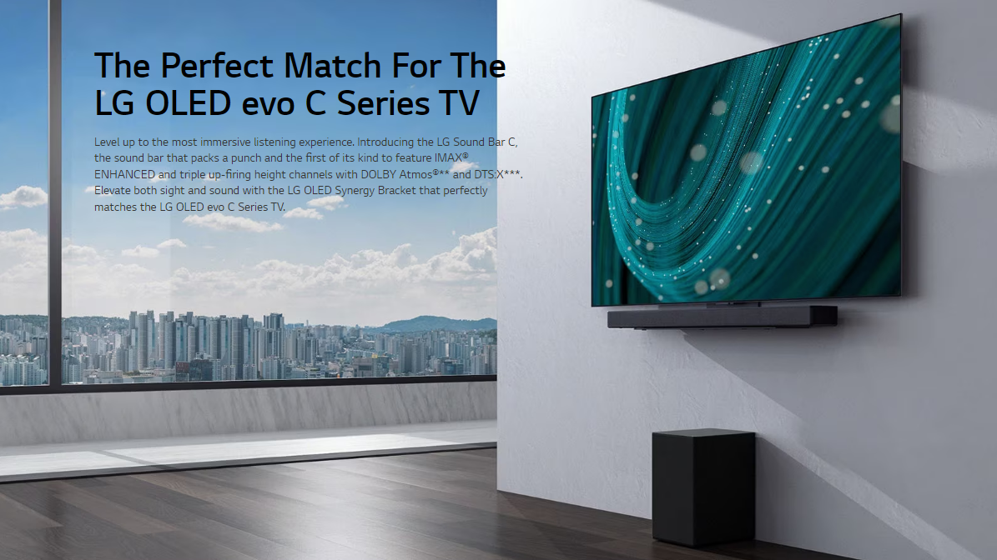
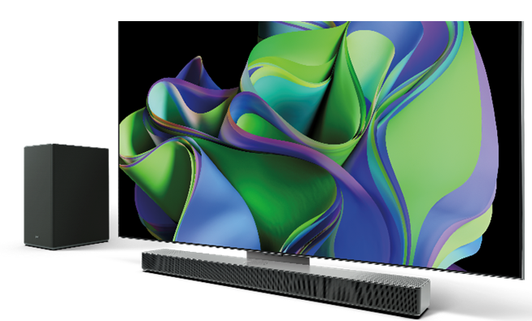
2023 New Sound Bar
OLED C Perfect Matching / SC9S
The biggest focus for 2023 is the improvement of the synergy between LG Soundbar and LG OLED TV. We did this in a few ways but the result is two-fold. 1. Improved Cosmetic Synergy (SC9S) and 2. Improved Audio Synergy (WOW Orchestra)
WOW Bracket for Cosmetic Synergy
The WOW Bracket comes in the box with the SC9S Soundbar for free. It can be used in both stand and wall mounted TV orientations.
Notes:
The WOW bracket comes in the box with the SC9S Soundbar. This bracket can be used to mount to any C series OLED evo TV – in both Wall Mounted TV applications or Table Top applications.
Benefit (Table Top) – Save space on your table by turning the soundbar into the base for the TV.
Benefit (Wall mounted) – No need to drill additional holes into the wall to get your soundbar mounted to the wall.
Benefit – When attached to the TV, it is positioned perfectly where it needs to be to give you the best Picture + Audio experience.

Slide 6
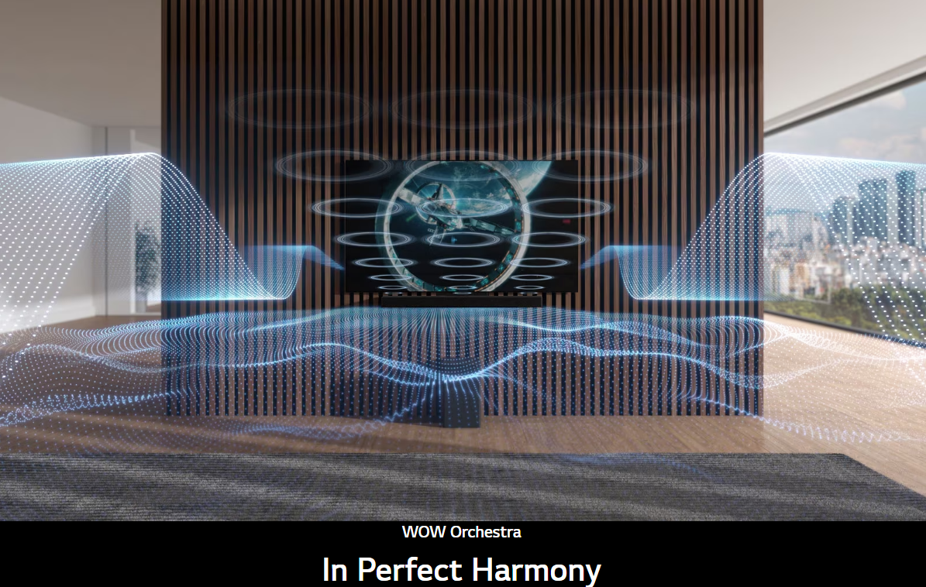
TV-Sound Bar Synergy
1. WOW Orchestra
Models : S95QR / S80QR / S80QY / S75Q / SC9S / SE6S / S77S
New
Provide convenience by strengthening interoperability function between LG TVs and Sound Bar
TV Speaker + Sound Bar sound output simultaneously
Best combination of TV and sound bar sound
With the perfect sync between LG products sound, TV and sound bar works like one speaker,. you can enjoy the three-dimensional sound as if you are in a concert hall
The Sound image from the Sound Bar moved to the center of TV screen to match the sound to the screen. This improves sound clarity and 3D sound effect
Convenient automatic setting
- When the Sound Bar is connected to the TV, it automatically operates in WOW Orchestra mode
- WOW Orchestra is available in all sound mode
- AI Sound Pro / Standard / Music / Cinema / Clear Voice Plus / Sports / Game / Bass Blast
- Considering each devices’ own speaker characteristics
* Connectivity : HDMI eARC
* Compatible TVs : OLED Z3/M3/G3/C3, LX3, LX1 OLED C2/B3/A3, QNED85/80/75, NANO77/75, UR80/75/73 (2023 2H Firmware update)
Notes:
When you connect a compatible WOW Orchestra LG Soundbar with a WOW Orchestra compatible TV the TV speakers can be used simultaneously with the Soundbar channels. This adds new immersion to your audio experience. It will provide a fuller, richer audio experience and more immersive than ever.
Compatible WOW Orchestra Soundbar models : S95QR / S80QR / S80QY / S75Q / SC9S / SE6S
Compatible WOW Orchestra TV Models : OLED Z3/M3/G3/C3, LX3, LX1 (To start the year) / OLED C2, QNED85/80/75, NANO75 (2023 2H Firmware update)
* In order to utilize WOW Orchestra you must connect the LG Soundbar to the LG TV via HDMI Cable using eARC

Slide 7
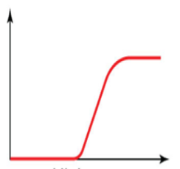
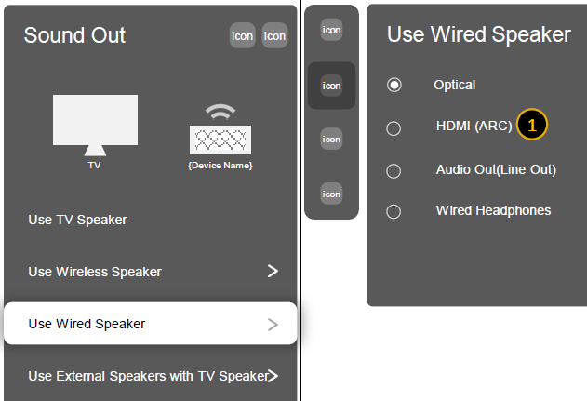
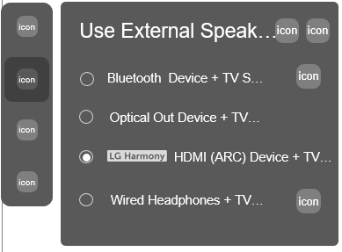
※ WOW Orchestra
Operation of TV & Sound Bar
Benefit of WOW Orchestra
Input
Output
TV plays mid & high range sound
Improving clarity / expanding the sound field
2ch / Multi-channel
High-pass
Screen & Sound matching by placing the sound in the center of the TV screen
Atmos /DTS:X
Bypass
Sound Bar plays main sound - Smart Up-mixer converts 2ch input into multi-channel for soundbar speaker configuration
When connected to the TV, it is automatically recognized and set to WOW Orchestra mode
9.1.5ch Up-mixing
(S95QR)
Settings > Sound Out
Quick Settings > Sound Out
WOW Orchestra
‘WOW Orchestra’ menu added
This menu is displayed only when a device supporting the WOW Orchestra function is connected.
WOW Orchestra is available in all sound mode.
- AI Sound Pro / Standard / Music / Cinema / Clear Voice Plus / Sports / Game / Bass Blast

Slide 8
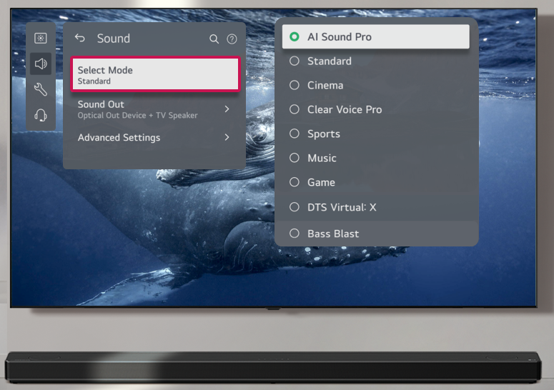
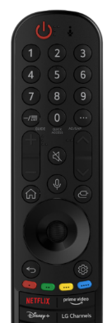
(Sound Mode Share) Models : S95QR / S80QR / S80QY / S75Q / S65Q / SC9S / SE6S
TV-Sound Bar Synergy
WOW Interface
(Volume UI) Models : S95QR / S80QR / S80QY / S75Q / S65Q / SC9S / SE6S
New
Provide convenience by strengthening interoperability function between LG TVs and Sound Bar
Sound Bar Sound Mode Share
Volume level display on the screen in improved UI
Automatically change to Soundbar’s Sound Effects when connecting LG TV to soundbar
Easy to recognize the volume level of the sound bar - Consistent volume display regardless of connection method such as HDMI / Optical
- You can manage the Sound Bar's sound effects through the TV screen with TV’s remote controller.
 | TV Speaker | Optical | Bluetooth | HDMI
~`22
`23~
+
17
-
17
17
17
17
* Compatible TVs : OLED Z3/M3/G3/C3 , LX3 (FLEX), LX1 (Pose) QNED85/80/75, NANO75,(2023 Initial)
* Connectivity : HDMI
Notes:
WOW interface adds more control elements to the TV user interface. This makes it more seamless to interact between the LG TV and the LG Soundbar. Just use the LG Magic remote and now you can control the preset audio settings. More informative menu screens, like the volume UI for example, give you more detailed information over your Soundbar

Slide 9
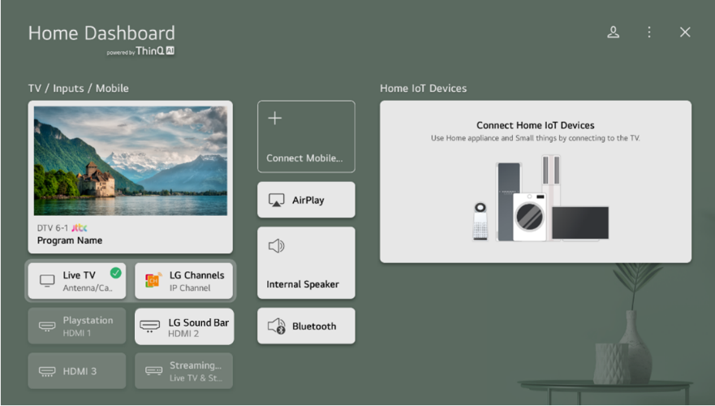
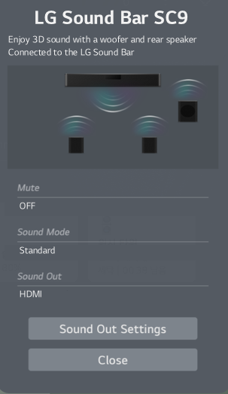
TV-Sound Bar Synergy
Models : S95QR / S90QY / S80QR / S80QY / S75Q / S65Q / SC9S / SE6S / S77S
WOW Interface
New
Provide convenience by strengthening interoperability function between LG TVs and Sound Bar
TV-Sound Bar Connection Information
Best combination of LG TV and LG Sound bar
Various information is displayed on the TV screen.
- Sound Bar model name, connection status, current sound mode of Sound Bar, connection status of rear speaker and subwoofer
Click !
* Compatible TVs : OLED Z3/M3/G3/C3/B3/A3, ART90, LX3, LX1 QNED99/85/80/75, NANO77/75, UR80/75/7, LQ6300/570B,LR600B (2023 Initial)
* Connectivity : HDMI

Slide 10
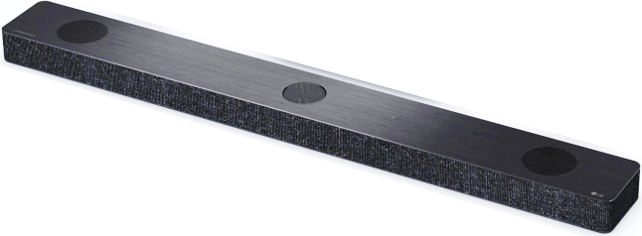
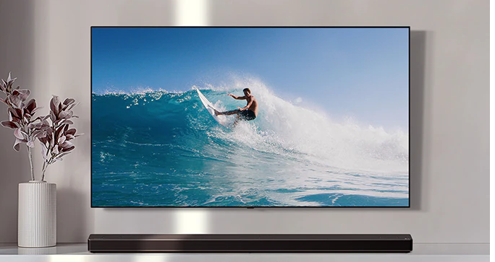
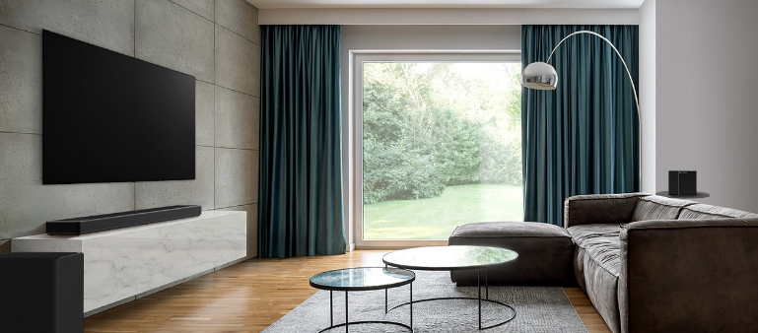
Immersive Sound
Center Up-Firing Speaker
Models : S95QR / S90QY / S80QR / S80QY / SC9S
`22
With the world’s 1st center up-firing speaker designed by LG, voice clarity and surround effect are further improved
World’s 1st Up-Firing Center Channel
The effect of center up-firing speaker
ATMOS Speaker
Center up-firing speaker moves the position of the dialogue to the center of the TV screen. By allowing the voice to come from a higher position, it matches the voice to the screen and improves voice delivery to the listener.
ATMOS Speaker
Center Up-Firing Speaker
Voice
Center Up-Firing Speaker
(Voice Position)
Front Center
Speaker

Slide 11
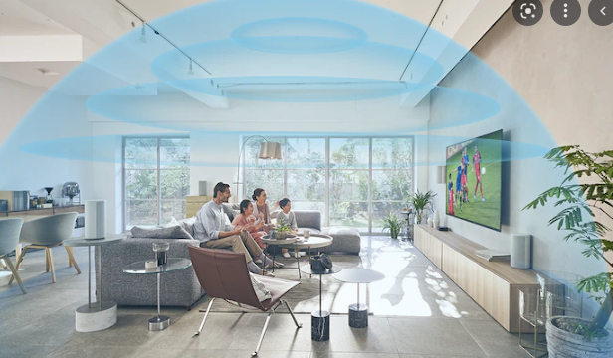
Triple AI Sound
1. Triple Level Spatial Sound
New
Triple Level Spatial Sound adds virtual layer, creating a dome of audio that makes your cinema experience more immersive
Channel analysis and HRTF-based 3D engine creates mid layer with virtual speakers for more immersive and accurate sound experience.
* The mid-layer is created using Sound Bar’s speaker channel. That is, the sound of the front and front-top speaker is synthesized to build a sound field. * If there is no rear speaker, the rear field cannot be created.
Virtual sound channels created in the middle layer realize richer and more sophisticated surround sound.
Top Layer
Front Top
Rear Top
Mid-Layer
(Virtual)
Mid-Layer
(Virtual)
[Front Top + Front ]
[Rear Top + Rear Front ]
Low Layer
Front
Rear Front
※ ‘Triple Level Spatial Sound’ is available in CINEMA / AI Sound Pro Mode of Sound Bar
1) HRFT : Head Related Transfer Function
Models : S95QR / S90QY / S80QR / S80QY / S75Q / SC9S / SE6S / S77S

Slide 12
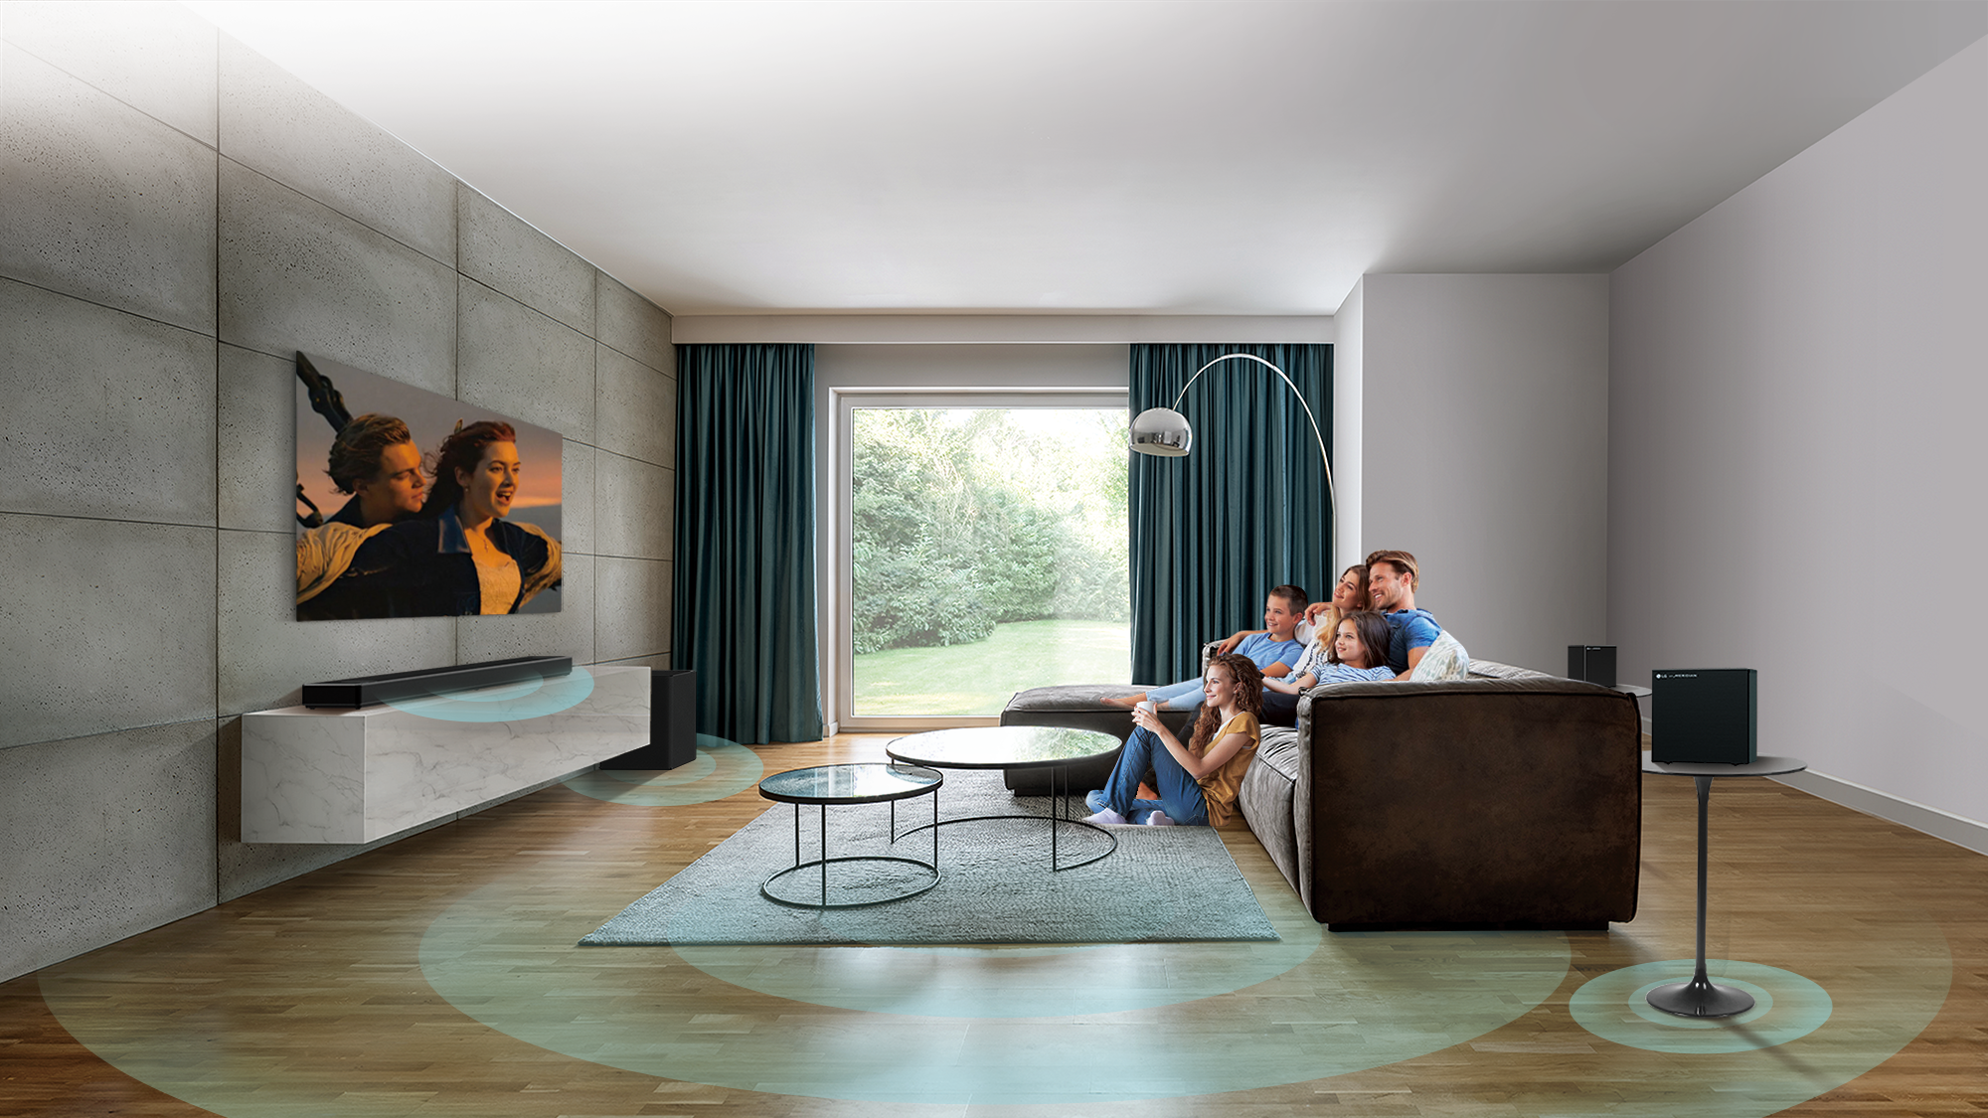
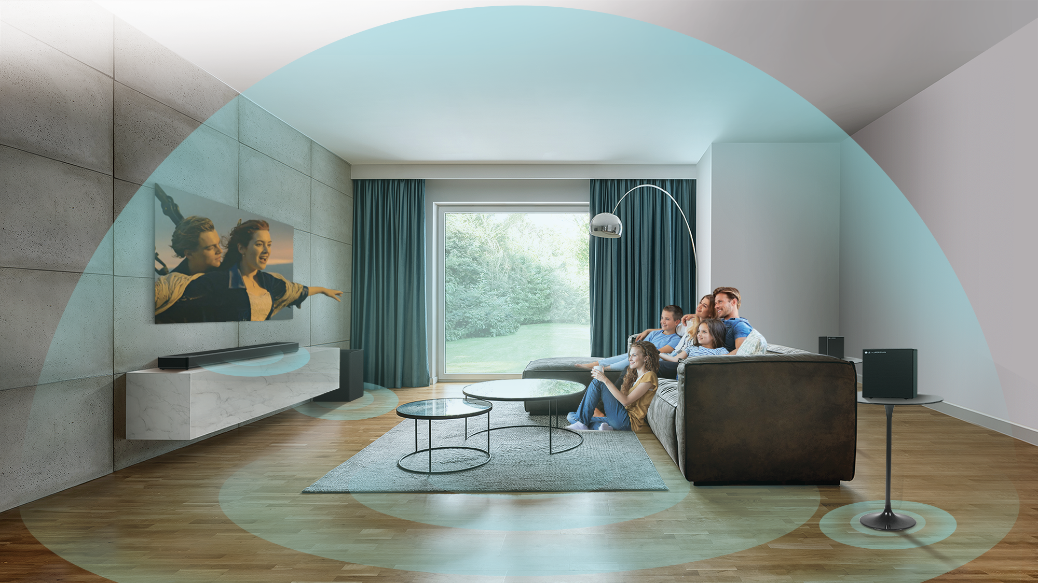
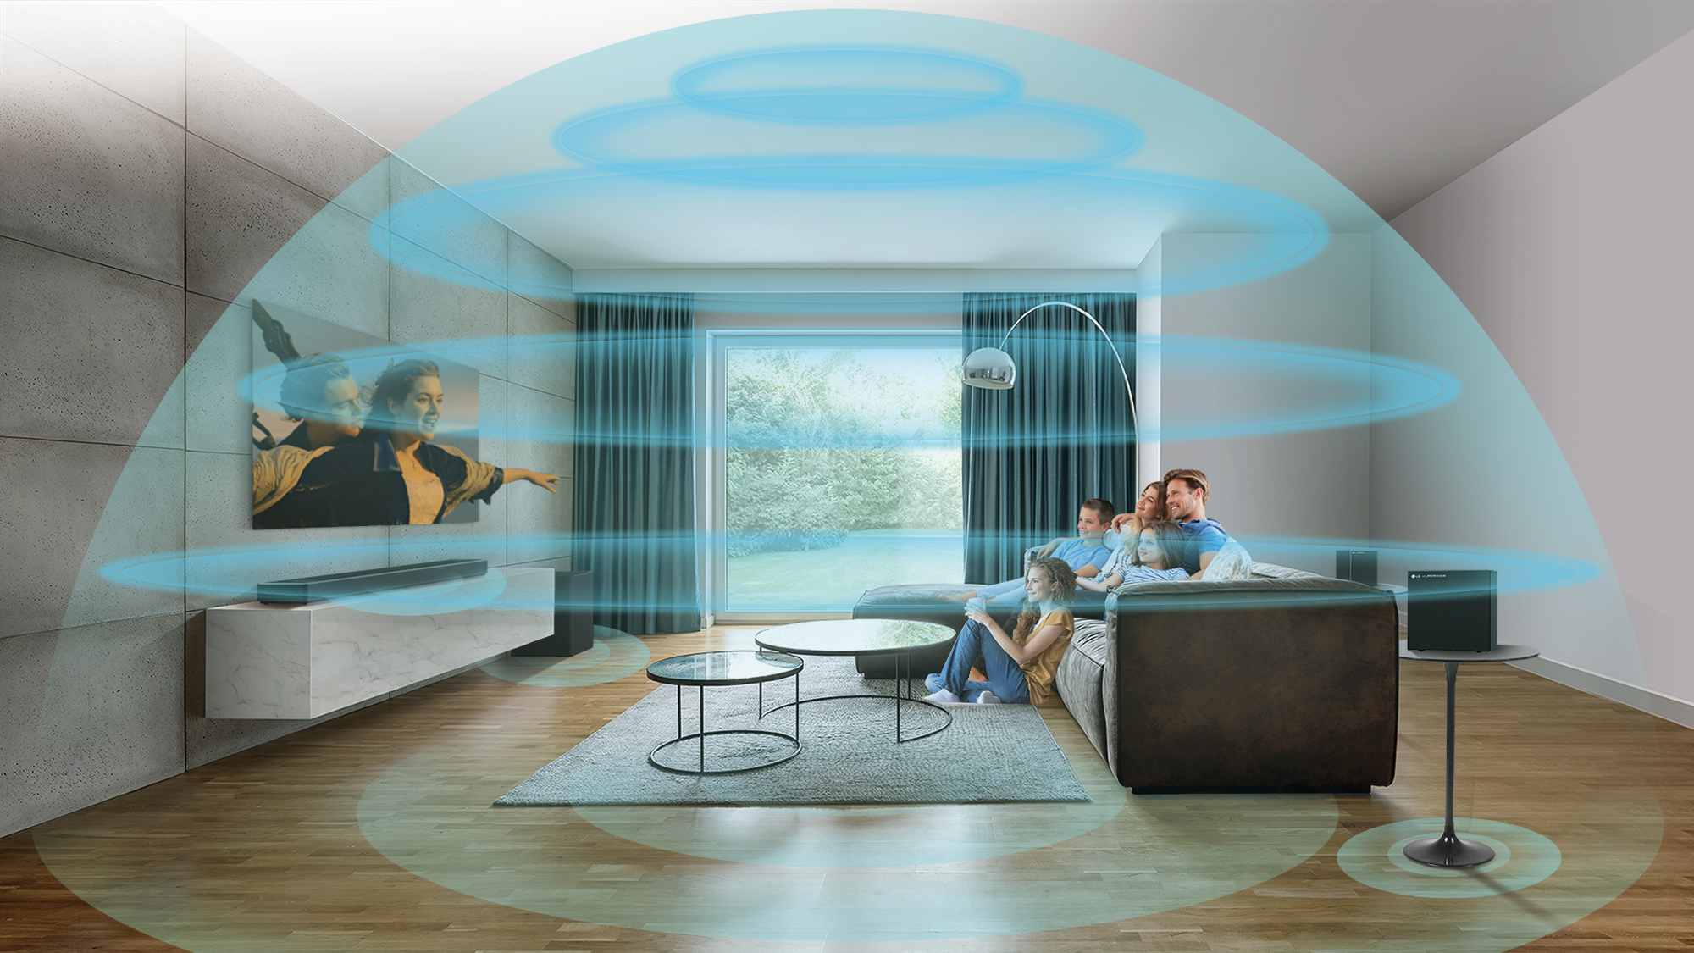
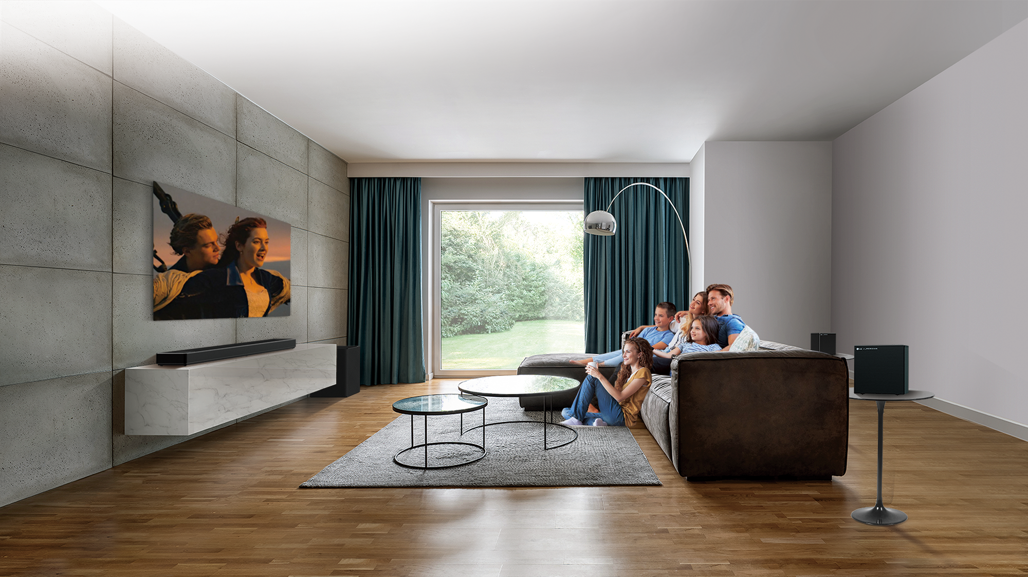
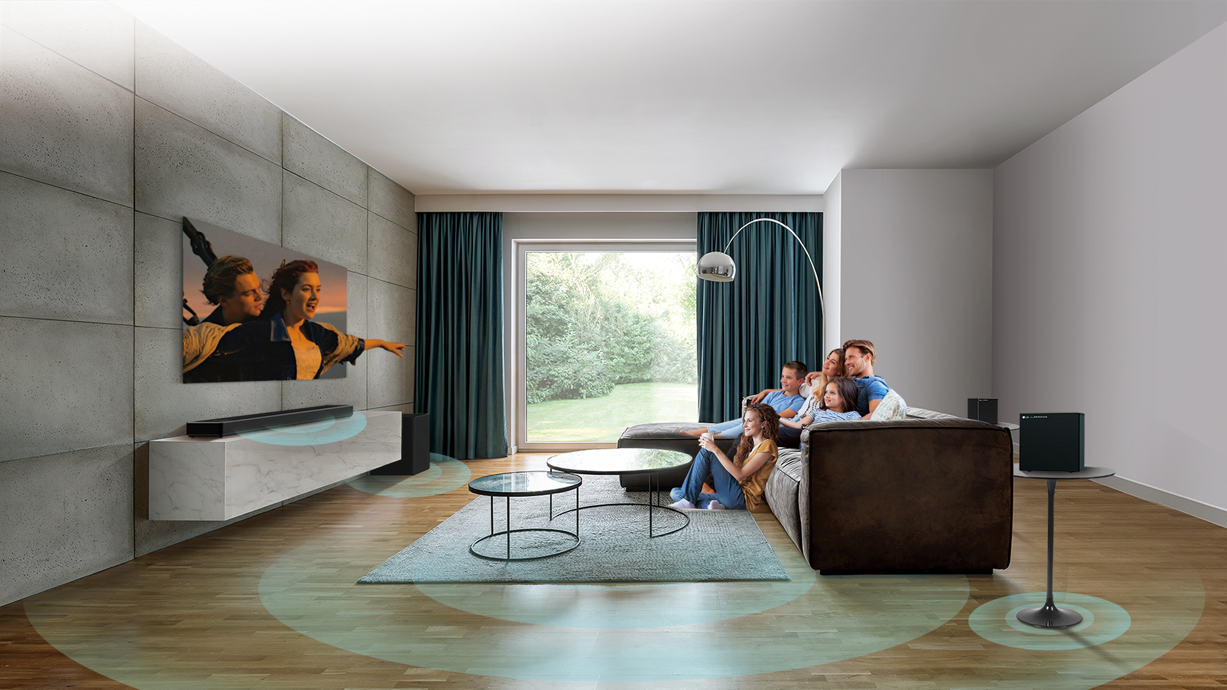
Triple Level Spatial Sound Technology for Larger Sound Stage
LGE Confidential
Triple Level Spatial Sound adds virtual layer, creating a dome of audio that makes your cinema experience more immersive
Up-firing channel level
Virtual level
Front channel level
Notes:
Increase spatial resolution

Slide 13
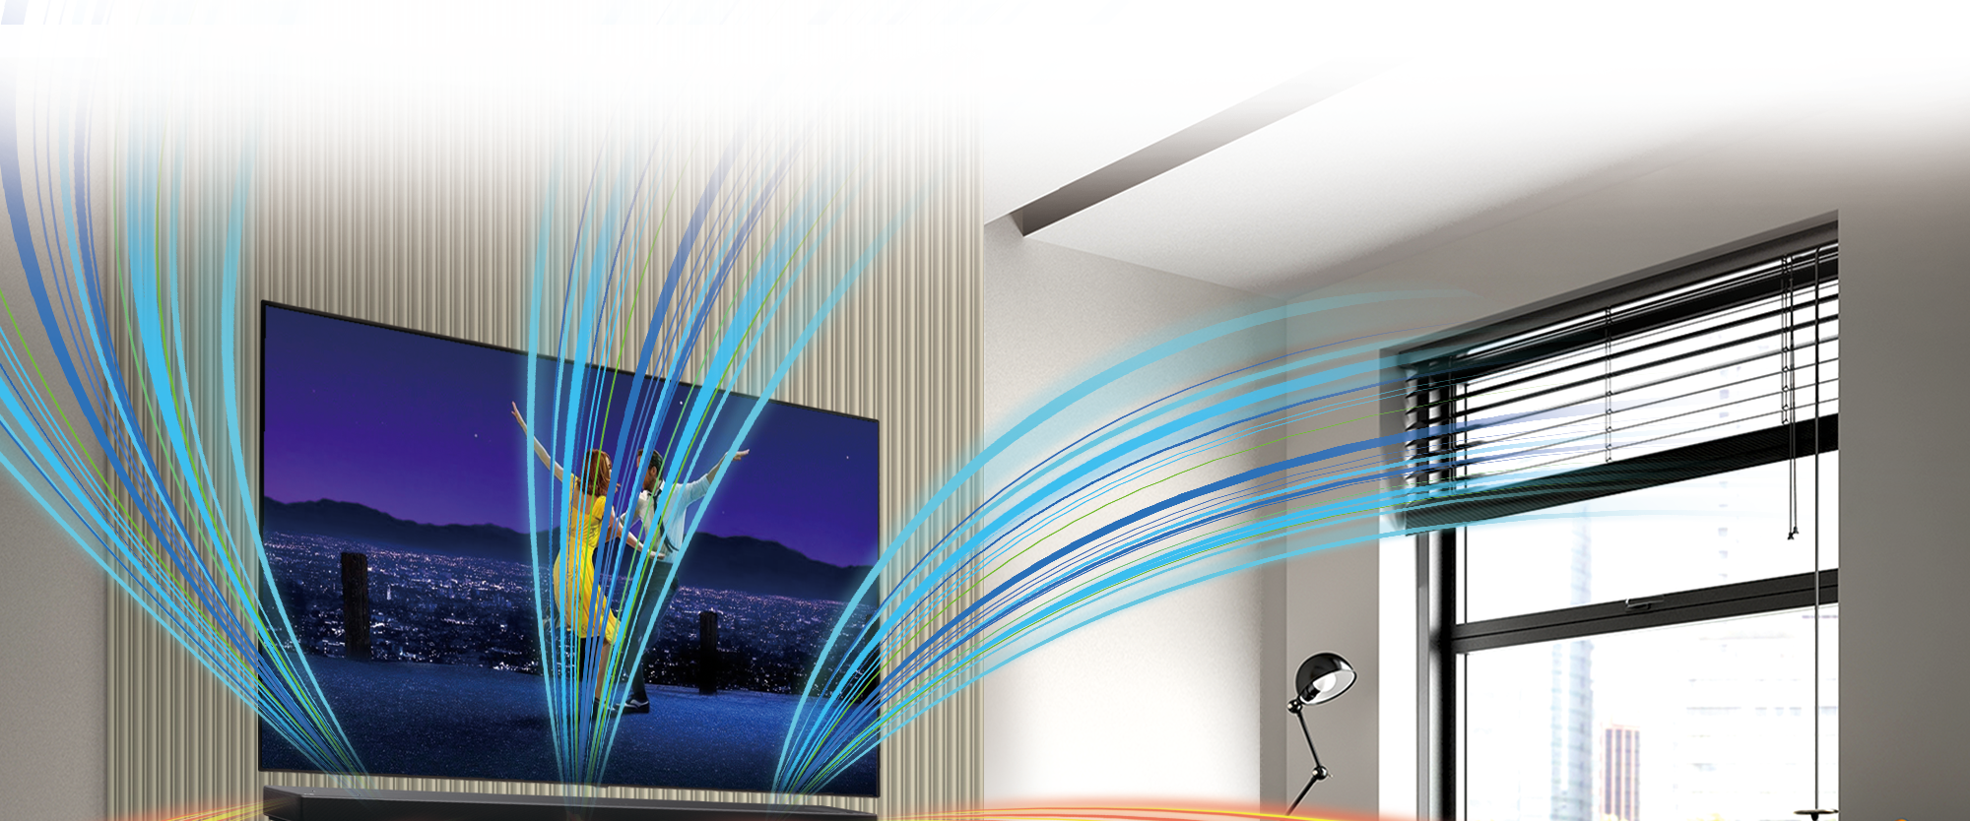
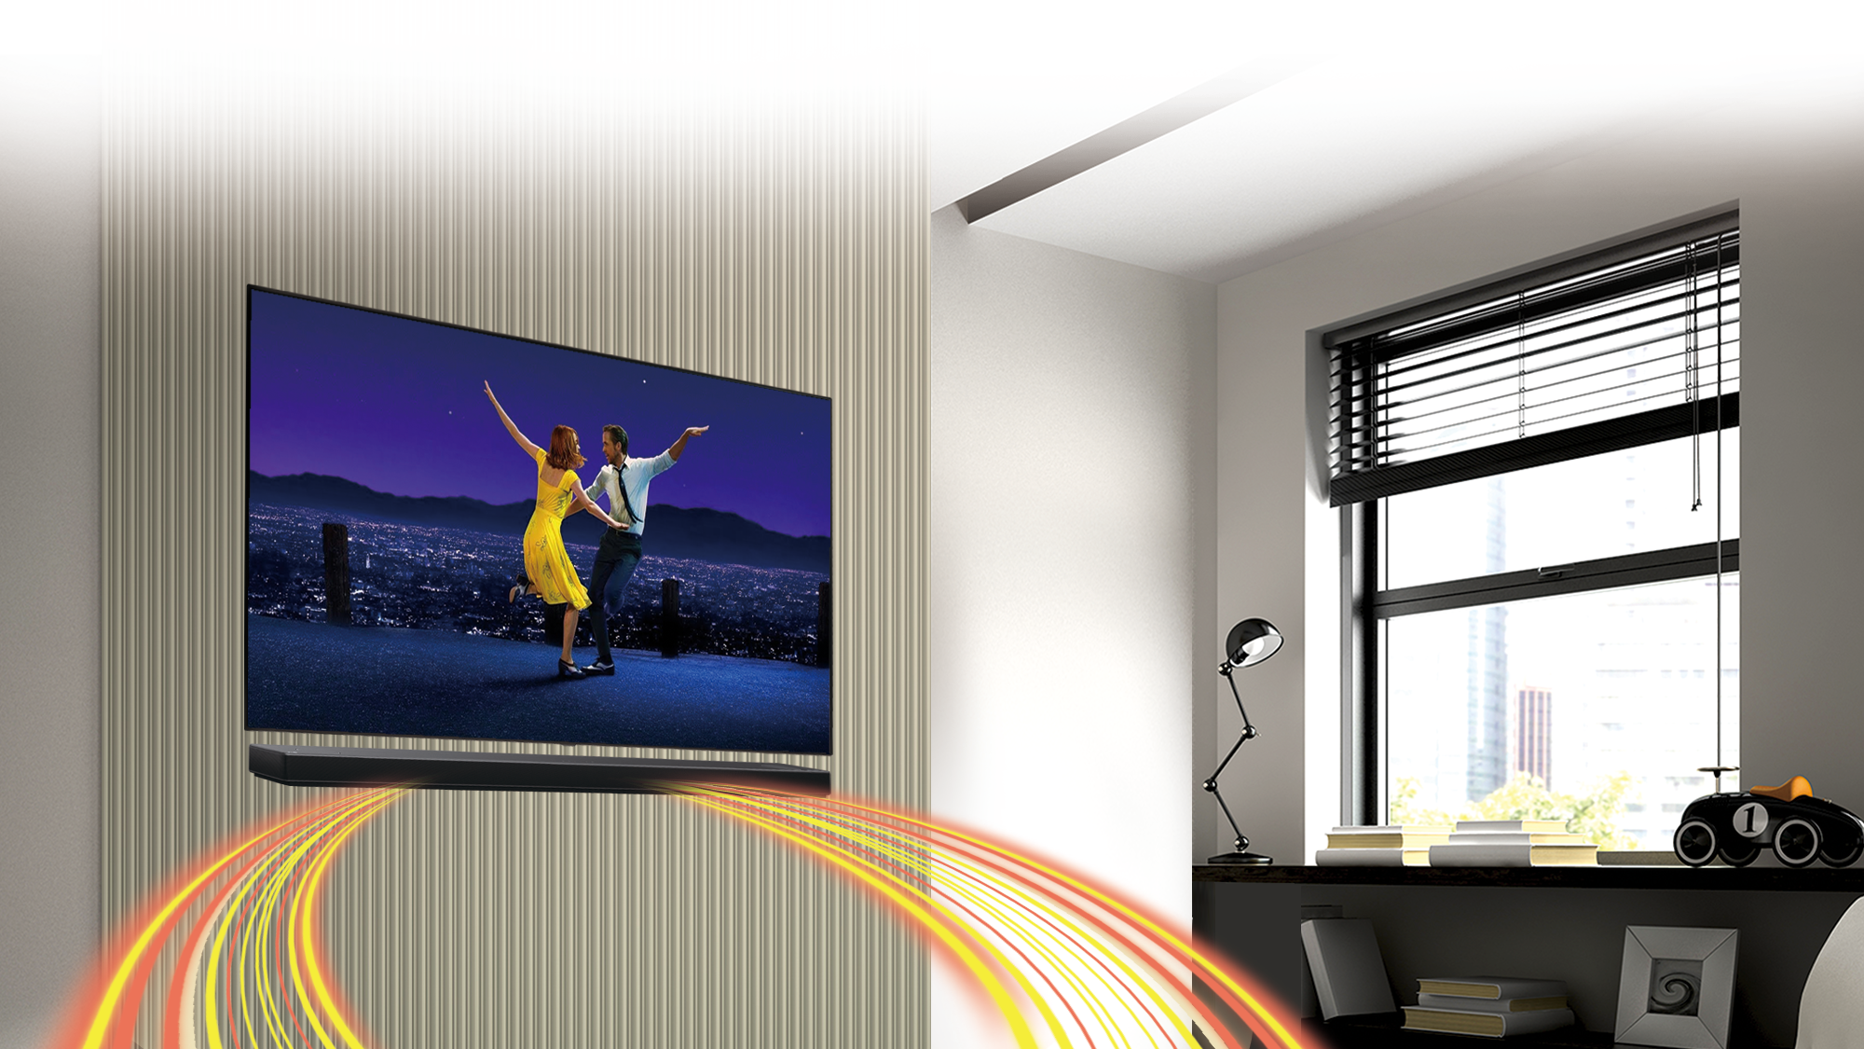
Triple AI Sound
2. Smart Upmixer
LGE Confidential
New
Models : S95QR / S80QR / S80QY / S75Q / S65Q / SC9S / SE6S
Perfect multi-channel output no matter what content is played
2ch
Conventional
2ch
2ch
LG’s Smart
Up-mixer
Up to
9.1.5ch
Smart Up-Mixer converts 2 channel audio into multi-channel surround sound for
a richer immersion of sound.

Slide 14
Triple AI Sound
2. AI Room Calibration Pro
Models : S95QR / S80QR / S80QY / S75Q / S65Q / SC9S / SE6S
For the optimal sound of the user's space, it analyzes the space and corrects the distortion of the sound.
How AI Room Calibration Works
What’s New in 2023
The LG Sound Bar analyzes the space and balances the sound bar audio settings to the environment.
Precisely match the reference frequency by subdividing the low frequency band below 400Hz into 16 sections
Frequency band expansion
Previous (2022)
Frequency band expansion
Before Calibration
-24
-30
-36
-42
-48
-54
-60
-66
100Hz
200Hz
400Hz
After Calibration
-24
-30
-36
-42
-48
-54
-60
-66
100Hz
200Hz
400Hz
Pattern matching across the entire frequency range
Reference
Your space

Slide 15
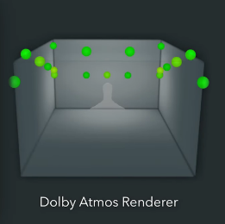
Hi-Fi Music Streaming
TIDAL Connect / MQA
New
Models : S95QR / S80QR / S80QY / SC9S / SE6S
TIDAL Music Streaming with LG Sound Bars
What is TIDAL Connect ¹⁾
TIDAL server
Phone
(TIDAL app)
You can enjoy the TIDAL library with 90M+ songs in maximum sound quality through TIDAL connect. (Audio quality options depends on subscription type)
Authentication / Control
Direct
Audio Source
(FLAC, AAC, DD+ ATMOS)
User can hear quality music the artist intended in MQA or immersive sound formats like Dolby Atmos or Sony 360 Reality Audio
Normal : AAC Quality
Enjoy Dolby Atmos Music with TIDAL
Easily accessible and the best compromise between data usage and sound quality
Dolby Atmos Music is available for all TIDAL HiFi Plus subscribers.
Dolby Atmos goes beyond the ordinary listening experience and puts you inside the song in a spatial way, revealing every detail of the music with unparalleled clarity and depth.
Sound
Quality
Hi-Fi : Loss-less Quality
Allows you to stream audio using the lossless format FLAC, creating a crisp and robust music streaming experience.
Master : High-Res Quality
Authenticated and unbroken, with the highest possible resolution — as flawless as it sounded in the mastering suite and precisely as the artist intended.
Dolby Atmos expands on existing
surround sound systems by adding
height channels.
*AirPlay 2 or Bluetooth transmits the audio source through the phone and is delivered to limited codec such as AAC/ALAC and SBC.
1) Source : TIDAL homepage (https://tidal.com/)

Slide 16
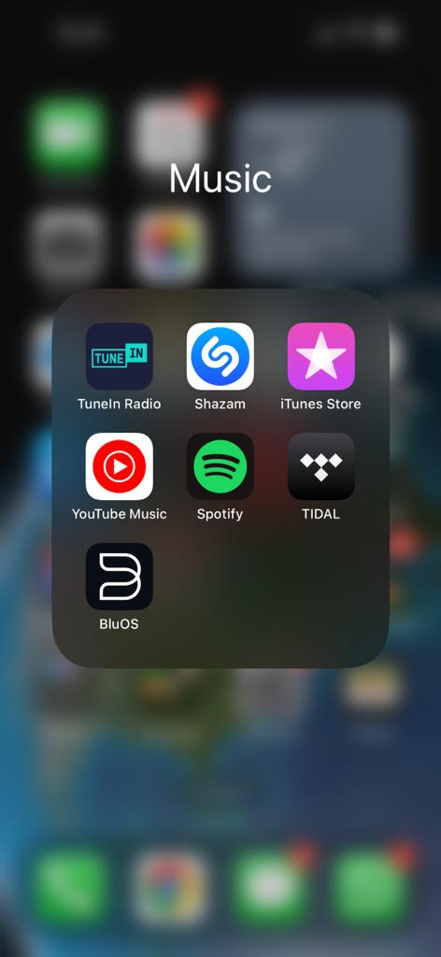
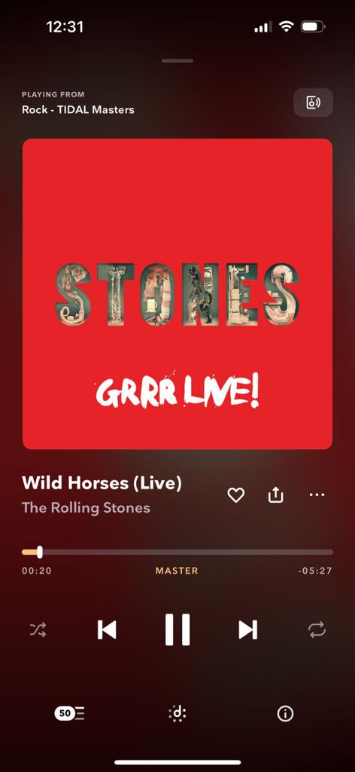
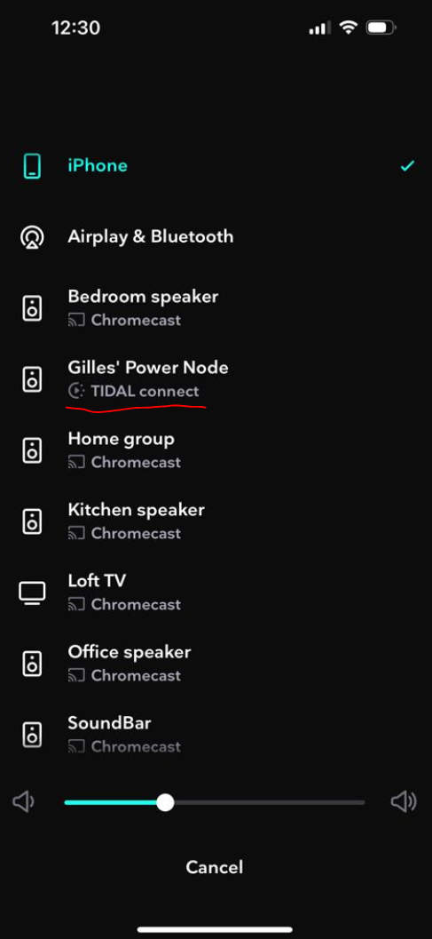
When you select Cast device you will notice Tidal Connect on compatible LG Sound Bars
Enjoy Studio Master Quality High Resolution Audio
Download the TIDAL App

Slide 17
Perfect Gaming
120 Hz Pass-through
Models : S95QR / S80QR / S80QY / SC9S / SE6S
New
Provides smoother video experience without blurring
In addition to VRR/ALLM, which provides a smooth screen by reducing or eliminating lag and frame tearing, 4K/120Hz pass-through allows you to enjoy the game with the best image quality.
2022
60Hz
※ 60Hz : Low sharpness on fast moving video
120Hz
2023
※ 120Hz : Provides smoother video experience without blurring

Slide 18
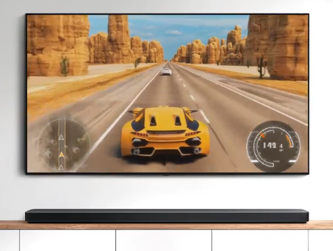
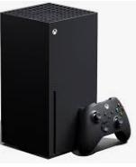
Perfect Gaming
VRR / ALLM
Models : S95QR / S80QR / S80QY / SC9S / SE6S
`22
① VRR (Variable Refresh Rate)
It is a function that can express the video on the TV in a smooth and seamless screen when playing games. VRR allows the TV to match the speed of the source and deliver images with less ripping and tearing
② ALLM (Auto Low Latency Mode)
It is a technology that reduces processing delays and shows the input from the source, to minimize the delay on the screen.
※ Both TV and Sound Bar must support VRR/ALLM
The game console can be directly connected to the sound bar with VRR/ALLM support

Slide 19
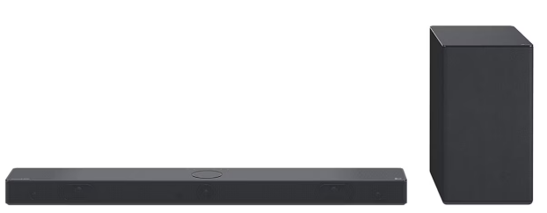
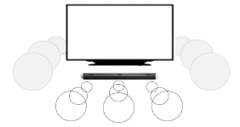
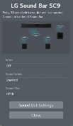
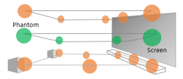
2023 New Sound Bar
OLED C Perfect Matching / SC9S
A must-have item for LG OLED TV. Sound and design matching for the new entertainment experience
OLED C Perfect Matching
SC9S – With WOW Bracket in the Box
Perfect Harmony Design with OLED C
Optimized Compatibility with LG TV
Visual sophistication thanks to a single design - Unified design identity from the Sound Bar with TV - Aesthetically balanced design taking into account the sizes of both the Sound Bar and TV
WOW Orchestra / WOW Interface
TV + Sound Bar sound output simultaneously
Various information of
Sound Bar connection is displayed on the screen
Immersive Sound with Triple AI sound
Best Audio Solution : Dolby Atmos & DTS:X, IMAX Enhanced
New LG’s - Triple AI Sound :Triple Level Spatial Sound / Smart Up-Mixer / AI Calibration Pro
The synergy bracket provides optimal sound, perfect design matching and stable installation with the TV whether it is a TV stand type or a wall mount - No need to drill a hole in the wall for Sound Bar installation
Works with Both the OLEDC2 and OLEDC3 in 55”/65”/77”
2 ch
9.1.5 ch*
Triple Level Spatial Sound :
Creates mid-layer for immersive surround sound experience
Any source including 2 channel audio will be converted into multi-channel audio
OLED C2/C3 55/65/77” matching
Notes:
The WOW bracket comes in the box with the SC9S Soundbar. This bracket can be used to mount to any C series OLED evo TV

Slide 20
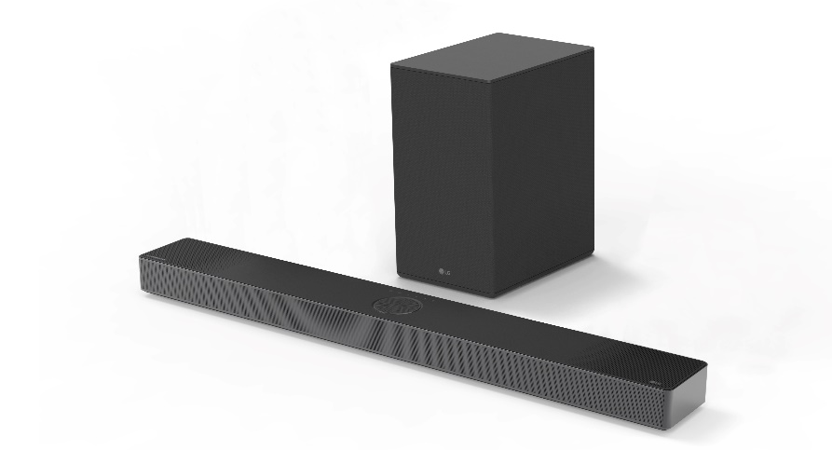
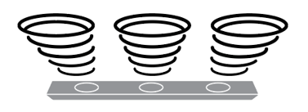
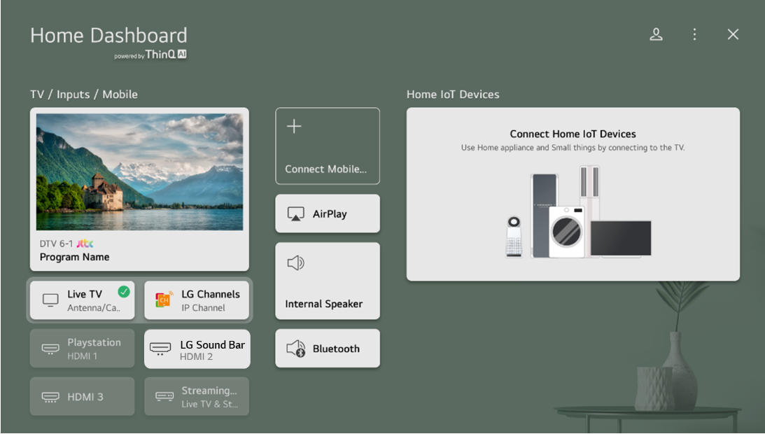
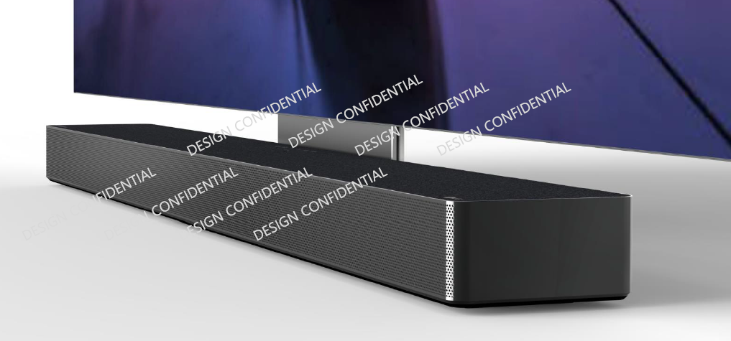
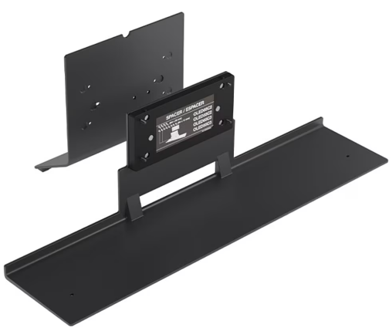
SC9S
“ Perfect OLED C Matching Sound Bar”
Comes with the WOW Bracket
Key Feature & Highlight
SC9S
Size (WHD, mm ) : 920x63x125
Dolby Atmos 3.1.3 ch with Triple Up-Firing Speaker
Best Audio Solution : Dolby Atmos & DTS:X / IMAX Enhanced Audio
Triple AI Sound with Triple Level Spatial Sound & Smart Up-Mixer
Channel
3.1.3 ch (Center Up-Firing)
Power
400W
Triple Level Spatial Sound
Smart Up-Mixer
Sound
Dolby Atoms / DTS:X IMAX Enhanced Audio
Triple Level Spatial Sound
Smart Up-mixer
WOW Orchestra
Hi-Res Audio (24bit / 96kHz)
AI Sound Pro / Clear Voice Plus
Best Matching Sound Bar with LG TV :
WOW Orchestra & WOW Interface
Connectivity
HDMI 1 In/ 1 Out (eARC), - VRR/ALLM /120Hz Support
Optical
Wi-Fi, Bluetooth
Perfect Matched Design with LG OLED C (WOW Bracket)
Convenience
Works with Google/Alexa Apple Airplay2
Spotify / Tidal Connect
4K Pass-through
AI Room Calibration Pro
Voice Feedback
LG TV Synergy
Multiple AI Services & Music Streaming Compatibility
Eco
SGS Eco Product
UL ECV
Energy Star

Slide 21
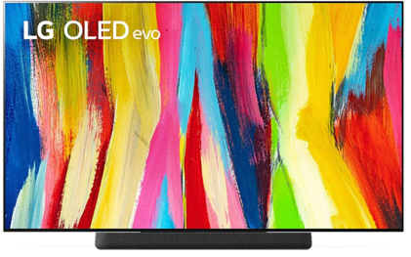
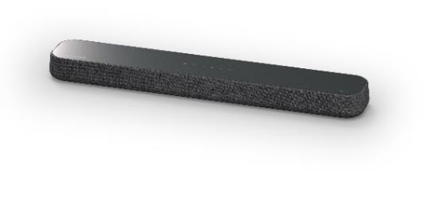
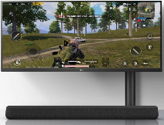
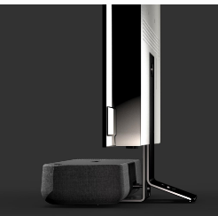
2023 New Sound Bar
Lifestyle Sound Bar / SE6S
Compact & minimal design that can be matched to various spaces and excellent bass sound despite the woofer-less design
Lifestyle Matching
SE6S
Woofer-less minimal design considering interior matching and lifestyle
Interior matching & stylish round shape design with fabric
Compact and simple woofer-less design for space saving
Sound Technology in a compact design
Latest features for the lifestyle and entertainment
Dolby Atmos, DTS:X, Hi-Res Audio
Total solution for Hi-Res music : - Spotify, TIDAL, Chromecast, Airplay2,
4-Passive radiators increase sound pressure and make powerful & rich bass sound without subwoofer
More natural and smooth gaming : 4K / 120Hz Pass-through
By applying a wideband 1” tweeter, user can enjoy clearer mids & highs

Slide 22
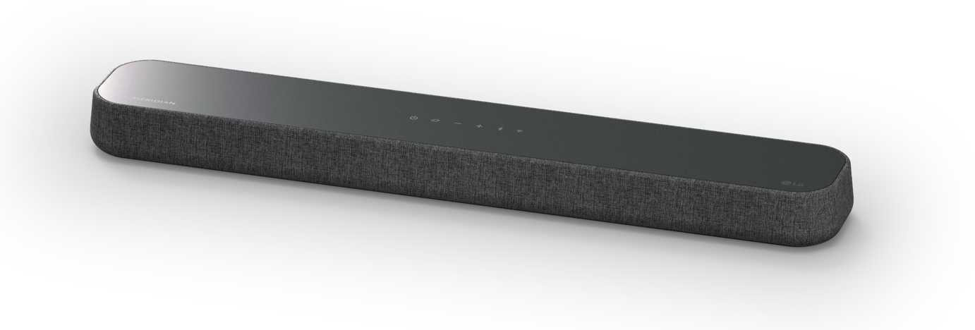
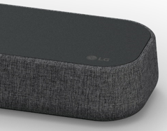
SE6S
“Lifestyle Sound Bar”
Key Feature & Highlight
SE6S
Size (WHD, mm ) : 800 x 63 x 125
Interior Matching Wooferless Design
Best Audio Solution : Dolby Atmos & DTS:X
4-Passive Radiators
Channel
3.0 ch (Subwoofer B/I)
Triple AI Sound - Surround Sound with Triple Level Spatial Sound & Smart Up-Mixer
Power
100W
Sound
Dolby Atoms / DTS:X
Triple Level Spatial Sound
Smart Up-mixer
WOW Orchestra
AI Sound Pro / Clear Voice Plus
Triple Level Spatial Sound
Smart Up-Mixer
Best Matching Sound Bar with LG TV : WOW Orchestra & WOW Interface
Connectivity
HDMI 1 In/ 1 Out (eARC), - VRR/ALLM/120Hz Support
Optical
Wi-Fi, Bluetooth
Convenience
Works with Google/Alexa Apple Airplay2
Spotify / TIDAL Connect
4K Pass-through
AI Room Calibration Pro
Voice Feedback
LG TV Synergy
Multiple AI Services & Music Streaming Compatibility
Eco
SGS Eco Product
UL ECV
Energy Star
* The word “WOW” cannot be used in Peru.

Slide 23
Summary of `23 New Features
S95QR
SC9S
S80QR
S80QY
S75Q
S65Q
SE6S
Triple Level Spatial Sound
Channel analysis and HRTF-based 3D engine creates mid layer with virtual speakers for more immersive and accurate sound experience
O
O
O
O
O
-
O
Smart Up-Mixer
Any source including 2 channel audio will be converted into multi-channel audio optimized for sound bar’s channel configuration.
2ch
O
O
O
O
O
O
O
Immersive
Sound
Clear Voice Plus
LG’s Smart
Up-mixer
Up to
9.1.5ch
Through correlation analysis of L/R channels, more realistic center and center top sound are created to improve voice clarity.
O
O
O
O
O
O
ex. S95QR
(depends on
channel configuration)
AI Room Calibration Pro
The frequency range of room calibration is expanded from 200Hz / 8 sections to 400Hz / 16 sections covering front and center channel to further improve voice, balance, and sound image.
O
O
O
O
-
-
WOW Synergy
WOW
Orchestra
WOW
Orchestra
WOW
Orchestra
WOW
Orchestra
WOW
Orchestra
WOW
Orchestra
Harmony
With
LG TV
WOW Orchestra : Offers a greater immersive experience by using all speakers from TV and sound bar.
WOW
Interface
WOW Interface : Lets users understand sound bar status and control TV and sound bar conveniently.
WOW
Interface
WOW
Interface
WOW
Interface
WOW
Interface
WOW
Interface
WOW
Interface
Hi-Fi Music Streaming
TIDAL, premium Hi-Fi streaming service is another new addition, supporting MQA codec to enjoy TIDAL's highest level of Master sound quality.
(Normal: AAC, Hi-Fi: FLAC, Master: MQA)
O
O
O
O
-
-
-
Lifestyle
Perfect Gaming with 120Hz
New
60Hz
VRR / ALLM / 120Hz Pass-through
+
O
O
O
O
-
-
O
4K /120Hz support for the seamless gaming experience.
120Hz

Slide 24
6. `23 PRM Overview (Feature Upgraded of `22 Models)
 | S95QR | SC9S | S80QR | S80QY | S75Q | S65Q | SE6S
Size (W x H x D, mm) | 1200x63x135 | 975x63x125 | 1000x63x135 | 1000x63x135 | 890x65x119 | 1000x63x105 | 800 x 63 x 131
Total Wattage | 810W | 400W | 620W | 480W | 380W | 420W | 100W
Channels | 9.1.5 | 3.1.3 | 5.1.3 | 3.1.3 | 3.1.2 | 3.1 | 3.0
Rear Speakers | 4.0.2 | - | 2.0.0 | Option | - | - | -
Dolby Atmos / DTS:X | O | O | O | O | O | - | Virtual
IMAX Enhanced | O | O | O | O | - | - | -
Triple Level Spatial Sound | O | O | O | O | O | - | O
Smart Up-Mixer | O | O | O | O | O | O | O
Clear Voice Plus | O | O | O | O | O | O | O
AI Room Calibration Pro | O | O | O | O | - | - | O
Meridian / Hi-Res Audio | O | O | O | O | O | O | X
Spotify / TIDAL Connect (MQA) | O | O | O | O | - | - | O
VRR, ALLM, 120Hz | O | O | O | O | - | - | O
HDMI (eARC) 4K Pass-through w/ Dolby Vision | O | O | O | O | O | - | O
LG TV Synergy | O | O | O | O | O | WOW Interface | O
Sound Bar Mode Control | O | O | O | O | O | O | O
Multiple AI Compatible | O | O | O | O | - | - | O
WOWCAST Compatible | O | O | O | O | - | - | O
Eco Friendly Product | O (+Carbon Trust) | O | O | O | O | O (+Carbon Trust) | O
HDMI cable | O | O | O | O | O | Optical | O
SOUND
CONV.
WOW Orchestra, WOW Interface
works with Google/Alexa, Airplay 2
ECO
SGS / UL ECV / Energy Star
ACC’Y

Slide 25
SC9S
“ Perfect OLED C Matching Sound Bar ”
Key Feature & Highlight
Best Matching Sound Bar with LG TV :
WOW Orchestra & WOW Interface
Perfect Matched Design with LG OLED C
- Dual Mode Bracket (included)
Dolby Atmos 3.1.3 ch with Triple Up-Firing Speaker
Size (WHD, mm ) : 975 x 63 x 125
SC9S
Best Audio Solution : Dolby Atmos & DTS:X / IMAX Enhanced
Channel
3.1.3 ch (Center Up-Firing)
Convenience
Works with Google/Alexa Apple Airplay2
Spotify / Tidal Connect
4K Pass-through
AI Room Calibration Pro
Voice Feedback
WOW Interface
Power
400W
Sound
Dolby Atoms / DTS:X IMAX Enhanced
Triple Level Spatial Sound
Smart Up-mixer
WOW Orchestra
Hi-Res Audio (24bit / 96kHz)
AI Sound Pro / Clear Voice Plus
Real 3D Surround Sound with
Triple Level Spatial Sound & Smart Up-Mixer
Eco
SGS Eco Product
UL ECV
Energy Star
Triple Level Space Sound
Smart Up-Mixer
Multiple AI Services & Music Streaming Compatibility
Connectivity
HDMI 1 In/ 1 Out (eARC), - VRR/ALLM /120Hz Support
Optical
Wi-Fi, Bluetooth

Slide 26
SE6S
“ Life-style All-in-One Soundbar”
Key Feature & Highlight
Interior Matching Woofer-less Design
- Best Audio Solution : Dolby Atmos & DTS:X
- 4-Passive Radiators
Size (WHD, mm ) : 800 x 63 x 131
Real 3D Surround Sound with
Triple Level Space Sound & Smart Up-Mixer
SE6S
Triple Level Space Sound
Smart Up-Mixer
Channel
3.0 ch (4-Passive Radiator)
Convenience
Works with Google/Alexa Apple Airplay2
Spotify / TIDAL Connect
4K Pass-through
AI Room Calibration Pro
Voice Feedback
WOW Interface
Power
100W
Best Matching Sound Bar with LG TV :
WOW Orchestra & WOW Interface
Sound
Dolby Atoms / DTS:X
Triple Level Spatial Sound
Smart Up-mixer
WOW Orchestra
AI Sound Pro / Clear Voice Plus
Eco
SGS Eco Product
UL ECV
Energy Star
Multiple AI Services & Music Streaming Compatibility
Connectivity
HDMI 1 In/ 1 Out (eARC), - VRR/ALLM/120Hz Support
Optical
Wi-Fi, Bluetooth

Slide 27
S95QR
“Truly Immersive 9.1.5 ch Surround Sound”
Key Feature & Highlight
Dolby Atmos 9.1.5 Ch with Triple Up-Firing Speaker
4.0.2 ch Rear Speaker Kit Included
6ch Rear Speaker for Room - Filling Surround Sound
Best Audio Solution : MERIDIAN / Dolby Atmos & DTS:X / IMAX Enhanced
Size (WHD, mm ) : 1,200 x 63 x 135
S95SR
Real 3D Surround Sound with
Triple Level Spatial Sound & Smart Up-Mixer
Channel
9.1.5 ch - 6 ch Rear Speaker Included
Convenience
Works with Google/Alexa Apple Airplay2
Spotify / TIDAL Connect
4K Pass-through
AI Room Calibration Pro
WOW Interface
Power
Triple Level Space Sound
Smart Up-Mixer
810W
Sound
MERIDIAN, Dolby Atoms, DTS:X IMAX Enhanced
Triple Level Spatial Sound
Smart Up-mixer
WOW Orchestra
Hi-Res Audio (24bit / 96kHz)
AI Sound Pro / Clear Voice Plus
Best Matching Sound Bar with LG TV :
WOW Orchestra & WOW Interface
Eco
SGS Eco Product
UL ECV
Carbon Trust
Energy Star
Multiple AI Platform Compatibility
Connectivity
HDMI 2 In/ 1 Out (eARC), - VRR/ALLM/120Hz Support
Optical
Wi-Fi, Bluetooth
Works with Google, Works with Alexa, Apple Airplay 2, Spotify / TIDAL Connect
Notes:
2022 Carryover

Slide 28
S80QR
“Reality Experience with 5.1.3 ch Surround Sound”
Key Feature & Highlight
Dolby Atmos 5.1.3 Ch with Triple Up-Firing Speaker
2.0 ch Rear Speaker Kit Included
2ch Rear Speakers for Room-Filling surround sound
Best Audio Solution : MERIDIAN / Dolby Atmos & DTS:X / IMAX Enhanced
Size (WHD, mm ) : 1,000 x 63 x 135
Real 3D Surround Sound with
Triple Level Spatial Sound & Smart Up-Mixer
S80QR
Channel
5.1.3 ch - 2 ch Rear Speaker Included
Convenience
Works with Google/Alexa Airplay2
Spotify / TIDAL Connect
4K Pass-through
AI Room Calibration Pro
WOW Interface
Triple Level Space Sound
Smart Up-Mixer
Power
620W
Sound
MERIDIAN, Dolby Atoms, DTS:X IMAX Enhanced
Triple Level Spatial Sound
Smart Up-mixer
WOW Orchestra
Hi-Res Audio (24bit / 96kHz)
AI Sound Pro / Clear Voice Plus
Best Matching Sound Bar with LG TV :
WOW Orchestra & WOW Interface
Eco
SGS Eco Product
UL ECV
Energy Star
Multiple AI Platform Compatibility
Works with Google, Works with Alexa, Apple Airplay 2, Spotify / TIDAL Connect
Connectivity
HDMI 1 In/ 1 Out (eARC), - VRR/ALLM/120Hz Support
Optical
Wi-Fi, Bluetooth
Notes:
2022 Carryover

Slide 29
S75Q
“Reality Experience with 3.1.2 ch Surround Sound”
Key Feature & Highlight
3.1.2 ch Dolby Atmos & DTS:X
MERIDIAN Audio Technology
Meridian
Horizon
Real 3D Surround Sound with
Triple Level Spatial Sound & Smart Up-Mixer
Size (WHD, mm) : 890 x 65 x 119
S75Q
Triple Level Space Sound
Smart Up-Mixer
Channel
3.1.2 ch (2 Up-Firing Speakers)
Convenience
WOW Interface
4K Pass-through
Bluetooth Stand-by
Power
380W
Best Matching Sound Bar with LG TV :
WOW Orchestra & WOW Interface
Sound
MERIDIAN, Dolby Atoms, DTS:X
Triple Level Spatial Sound
Smart Up-mixer
WOW Orchestra
Hi-Res Audio (24bit / 96kHz)
AI Sound Pro / Clear Voice Plus
Eco
SGS Eco Product
UL ECV
Energy Star
HDMI, Bluetooth
Powerful connectivity with Bluetooth and HDMI In/Out (eARC)
Connectivity
HDMI 1 In/ 1 Out (eARC),
Optical
Bluetooth
Notes:
2022 Carryover

Slide 30
S65Q
“Reality Experience with 3.1 ch Surround Sound”
Key Feature & Highlight
3.1 ch High Res Audio Sound Bar
MERIDIAN Audio Technology
Smart Up-Mixer : Optimized sound for any speaker configuration (2 ch → Multi-Channel)
Size (WHD, mm) : 1000 x 63 x 105
S65S
출력 채널은 사운드바 스피커 구성에 따름
Channel
3.1 ch
Convenience
WOW Interface
Bluetooth Stand-by
Power
420W
Best Matching Soundbar with
LG TV : WOW Interface
Sound
MERIDIAN
Smart Up-Mixer
Hi-Res Audio (24bit / 96kHz)
AI Sound Pro / Clear Voice Plus
Eco
SGS Eco Product
UL ECV
Carbon Trust
Energy Star
HDMI, Bluetooth
Connectivity
HDMI 1 In/ 1 Out
Optical
Bluetooth
Powerful connectivity with Bluetooth and HDMI In/Out (eARC)
Notes:
Carryover

